Slide 1
Prophetic Trajectories of Hope from San Salvador to Liverpool: A Celebration of the ministries of Oscar Romero, Austin Smith, Tom Cullinan and Kevin Kelly

Slide 2
Prophetic imagination focuses on the dominant crisis.

Slide 3
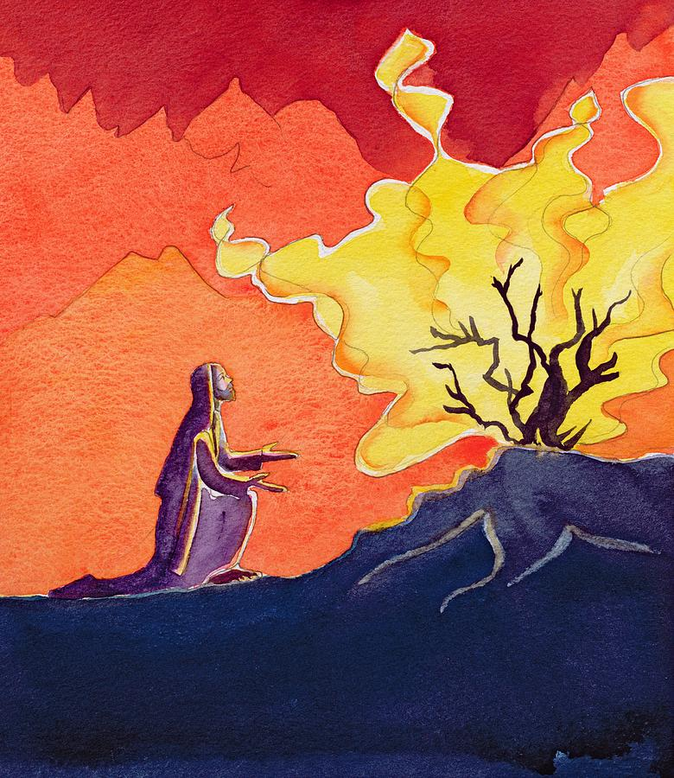
What’s in a name?Prophetic imagination as result of Encounter with the living God
The utterly free God Yahweh – “I am who I am, I will be who I will be, I will be where I will be”.
Through this encounter and what follows Moses is freed from the fixed religion, fixed gods, and fixed society of Pharaoh and Egypt.
Instead he is drawn into a different social reality created by Yahweh the utterly free God and he spearheads a radical social reality in response to that encounter.

Slide 4
The Prophetic Imagination of two Women
Two freed women who with extraordinary intensity express the prophetic imagination of their people and anticipate its renewal, as God comes close again in sovereign freedom, starting from the oppressed.
“

Slide 5
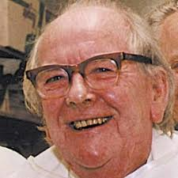
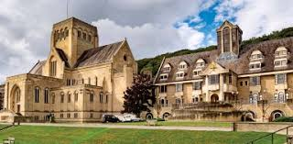
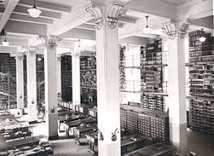
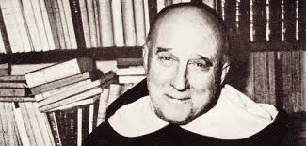
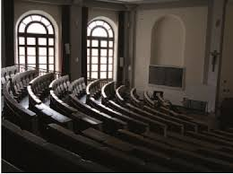
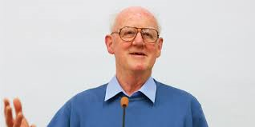
Unlikely Prophets from a less than Prophetic recent Tradtion

Slide 6
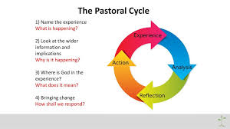
The Scholastic Method versus the Contextual.

Slide 7
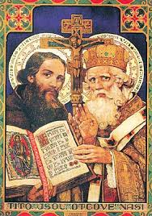
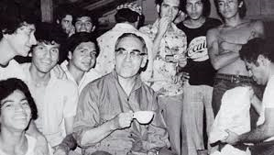
Sentire cum Ecclesia
To think with the Church
To feel with the Church

Slide 8
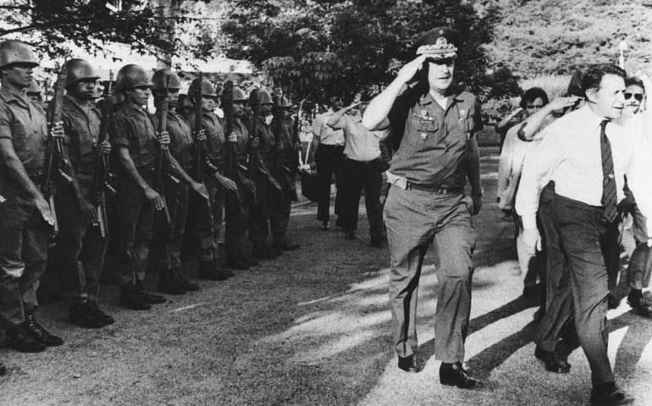
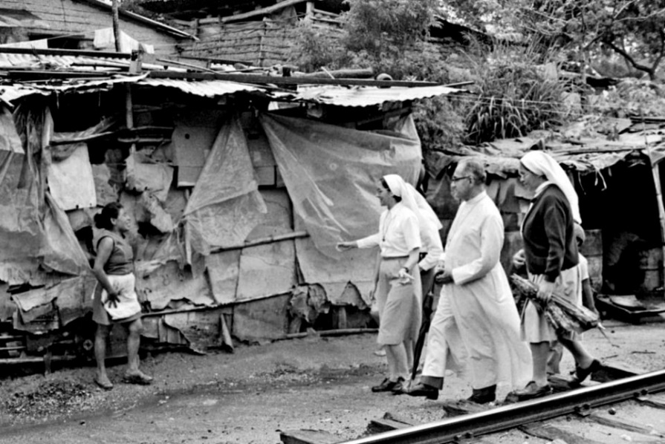
Archbishop of San Savador: The Kingdom of God versus the Powers. “Gloria Dei vivens Pauperum.”

Slide 9
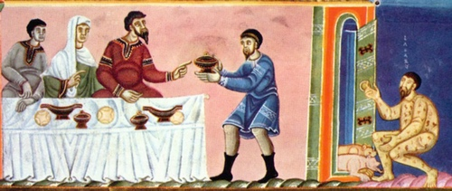
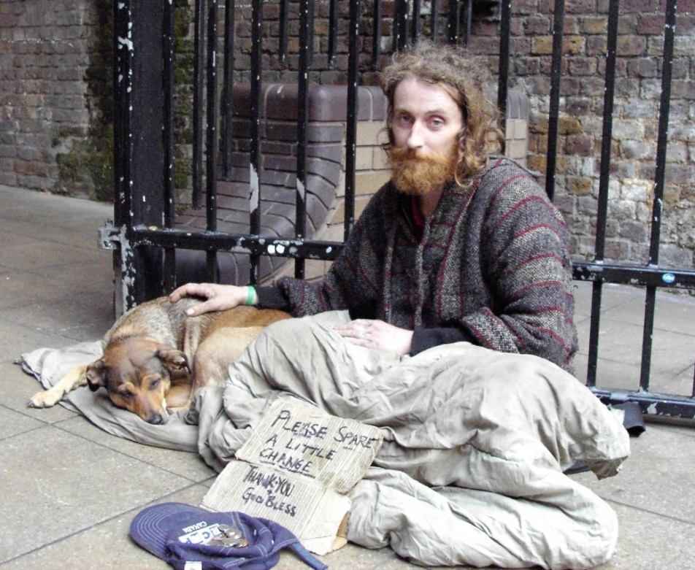
Romero reads the scriptures but now in a new context: “Blessed are the the destitute (ptochoi) for theirs is the Kingdom of God.”
Jesus parables open up the relationship between the stellar wealth of the minority super-rich and the growing poverty of the masses.
They are also given an insight into what might change things - a rediscovery and re-embracing of the vision of kinship and hospitality of Moses and the prophets.
The mercy of the covenant.

Slide 10
The Space of Grace
“”Wherever I am, I stand before the face of God. Whether the divine grace takes me up and brings me close to the divine mysteries in vision…or whether I am at the bottom of the pit and cry out Godwards, in danger of perdition, He is there and there is no need for me to look for him elsewhere. If God is not for me here , he is nowhere to be found…..Wherever wonder or broken-heartedness seizes upon us, we can turn Godwards, we can establish ourselves face to face with Him and cry to Him from the deep…This is monastic stability within one’s vocation. (Anthony Bloom)
“A true understanding of this name of God, at this stage of my life, becomes for me the root of all my believing. It leads me to an understanding of the totality of Jesus’ mission…a forgiving and …fulfilling love which we call grace…” out of this “…human beings must be able to see a future, and indeed, invest in a future in this world….I must not create or participate in the creation of any ‘not yet’ in history which blesses or spiritualises ideologies and institutions which marginalise and oppress the powerless. Indeed I must not even agree to co-exist with them never mind bless or spiritualise them. On the contrary, I must confront them. Not to do so is to blaspheme the name of God and the name of humanity by a process of manipulative escapism in the name of my own comfort.”(1990, pp 78-79)

Slide 11
The Events of the Week
In his radio sermons Romero starts from “the events of the week”. The radio homilies became one of the few ways that his people could find out what was really happening in their city, and their country; where a state controlled press consistently produced false news.
Now the reality, the events of the week, from the disappearing of dissidents, the terrorising of those ministering among the powerless and marginalised, the celebration of the birthday of a sister working in the slums or among the addicted, are deliberately brought into tension with the prophetic imagination of the scriptures and of Jesus parables of God’s living presence, the Kingdom.

Slide 12
Theology as Praxis
Not so much right thinking, the right answers to those right questions, set down so clearly by the right thinkers who did our thinking for us, but rather theology as shared, engaged, inspired right action, emerging from encounter with people’s lives. With Kevin Kelly as a teacher of moral theology you see this gradual transition from an always sensitive attempt to be faithfully and honestly orthodox to an increasing identification with those who orthodoxy had wounded and so to an engaged vision of faith a praxis that had to be developed
. .. that both raised up and centred our concern on them and challenged the conditions and the very orthodoxies that kept them oppressed.

Slide 13
Passion for the inner City (1983)
It took Austin Smith eight years of work and reflection with Nicholas Postlethwaite his former student and then fellow worker to break through the received certainties to the develoment of a true ministry in the midst of the marginal and the racial “other” in Toxteth among whom they lived and received wisdom from. The book is a narrative or story, a theology of creative collaborative ministry and a call to action.
Sitting in front of a turf fire in the west of Ireland a young religious devoured that book in one sitting letting the turf fire die as the night went on. Austin’s words fired her imagination and she wrote to him and he invited her and her congregation to join him.
Her name is Margaret Walsh and she extended the prophetic imagination to Birmingham.

Slide 14
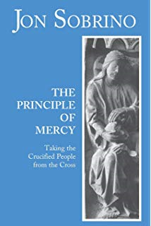
The Crucified People - who will take them down from the Cross?
Romero began to see the mass of his own people as radically one with the crucified Christ; with the God who out of love enters into the darkest that we can create or experience i.e. in Jesus the killing of innocent life by a corrupt state, and the denial of the presence of the living God by a fearful self-regarding religious leadership.
After the cross there is no dark place anymore where God cannot be for us as Tom’s reflection on stability implies. This conviction comes through Tom’s shared prayers and meditations, Austin’s poems and Kevin’s sermons and the ever more clearly focused talks and short papers and reports back from the various crises he investigated for Cafod.

Slide 15
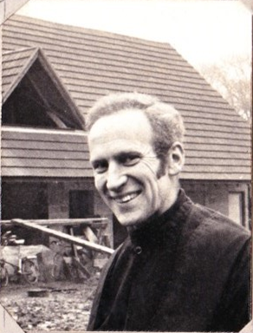
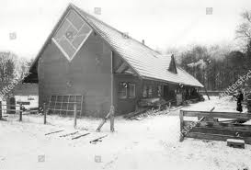
The Prophet of the Planetary
Ince Benet a large but simple wooden dwelling, self built , in which a small community could live at peace with its surrounding environment and provide facilities where those who would attempt to follow this simpler stripped down, prayer rooted , creation focused life might gather.
Many of the themes of Pope Francis’ Laudato Si are already anticipated – the need for a simpler lifestyle so that others might simply live, good but simple natural food, enough clothes but no excess, travel with the least impact on the land, education for a new politics and economics. And people came and went, gathered and talked and meditated, prayed, ate and drank and sang. And Tom went on his bike and spoke and shared the vision.

Slide 16
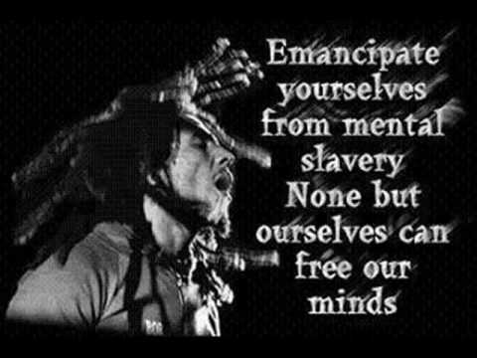
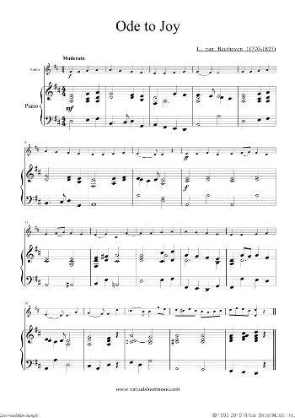
Praise and song, poems and dance. The power of doxology.

Slide 17
Criticism as Grief rather than Analysis
Grieving, the most visceral response to things not being right is the beginning of prophetic imagination and criticism. We see this in El Salvador around the deaths of Fr Rutilio Grande and all the innocents. And we see it in the fall out around the Toxteth riots.
The word to cry out has a double meaning: za’ak is both a cry of misery but it also means the filing of an official complaint. There is an expectation that the wrong which has been cried out will be responded to and answered.
“The people of Israel groaned under their bondage and cried out for help, and their cry under bondage came up to God. And God heard their groaning…”

Slide 18
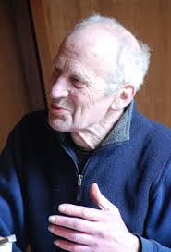
Lights along the Way
Tom like Moses was not able to enter the promised land but he enabled his people to see the way forward.
We still live with the tensions of racism, locally, nationally and internationally but Austin’s life in Toxteth points one way forward
Gender issues are still at the heart of current social debates but Kevin’s kindly and gentle exploration of sex and sexuality, of the nature of the good human life offer a light to all who come after him.

Slide 19
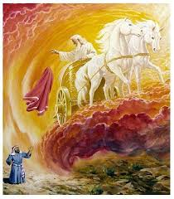
On taking up the Mantle of the Prophet
May we like the prophet Elisha receive the cloak from our Prophets….
No longer Elijah, but Oscar, Tom, Austin and Kevin , and may we do all they tried to and more in our own time of opportunity.
That would be the best homage we could pay them .

Slide 20
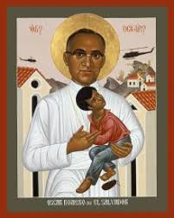
St Oscar Romero
“I ask all of you, dear brothers and sisters, to view these things that are happening in our historical moment with a spirit of hope, generosity, and sacrifice. And let us do what we can.”

